Slide 1



Lecture 10: Packet Management
COMP260: Distributed Systems
BSc (Hons) Computing for Games

Slide 2
Today’s session:
  User Management
  Data Packet issues
  Managing Network Data
  Workshop

Slide 3
User Management
  Did everything go ok in the last workshop?
  Any issues to report?

Slide 4
Data Packet issues

Slide 5
Data Packet issues
  You may have noticed that not all of your messages always make it from the server to the client
    Typically, we can get round this by throttling server->client sending
      1 socket.send() at a time
    However, pausing the client and running the server will demonstrate this problem

Slide 6
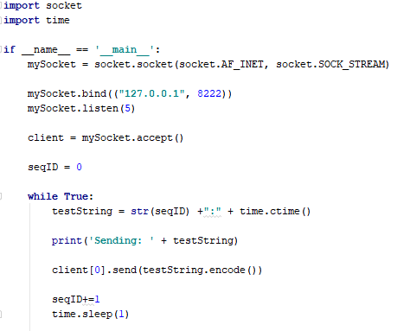
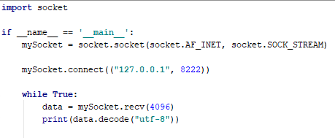
Data Packet issues
Client.py
Server.py

Slide 7
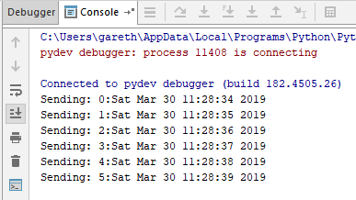
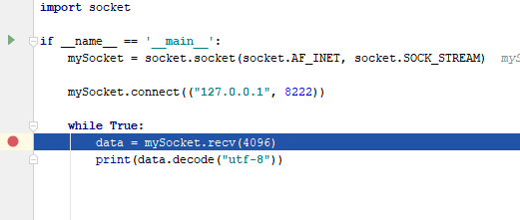
Data Packet issues
  Running the code
Client.py
If client is paused in debugger, data will still be sent
But not processed
Server.py

Slide 8
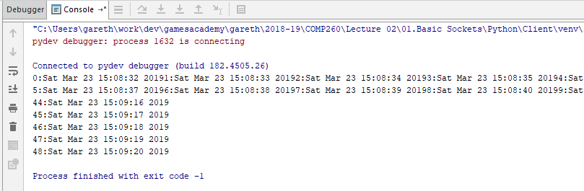
Data Packet issues
    Socket is effectively a pipe from server to client
      This is kind of ok a lot of the time
      In this case we ‘just’ end up with a lack of <CR> to break up the lines, but this looks nasty
      Could be worse if we need to process the input strings

Slide 9
Data Packet issues
    In part, this isn’t helped by the large value in the socket.recv
    How do we know what size of data we are dealing with?
    And how can we work out how many messages we are dealing with?

Slide 10
Managing Network Data

Slide 11
Managing Network Data
  Need to think of a more robust approach to network data
    This will also tie into packet data security
    Effectively our current data packet is:
      <DATA.N>
      Never a good plan to have N bytes of data when we don’t know what N is

Slide 12
Managing Network Data
  Approach 1: data parsing
    The data that comes of out socket.recv is an array of bytes
      We could:
        1. read an arbitrary about of bytes from socket.recv() and parse the array of bytes
          Like C/C++ style string parsing
        2. read the stream with socket.recv(1) to pop byte data and parse
      However,
        In this case, this data has no terminators like C-style strings, so we can’t take that approach
        We will need to create our own packet form to parse

Slide 13
Managing Network Data
  Approach 2: fixed length packets
    Let’s define a protocol for data communications where each message is 100 bytes in the length (other sizes are available
    Effectively a data packet of:
      <DATA.100>

Slide 14
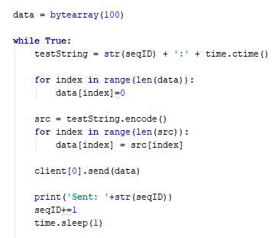
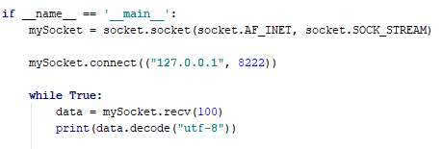
Managing Network Data
  Approach 2: fixed length packets
    Let’s define a protocol for data communications where each message is 100 bytes in the length (other sizes are available
Client.py
Server.py

Slide 15
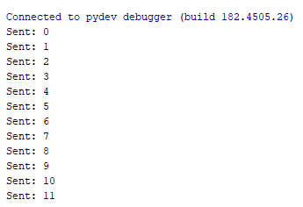

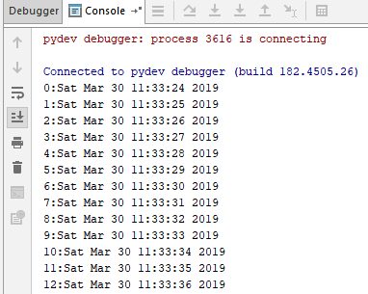
Managing Network Data
  Approach 2: fixed length packets
    If I run the client & server but leave the client on a breakpoint, the server will send messages and they will get queued up
Client.py
Server.py

Slide 16

Managing Network Data
  Approach 2: fixed length packets
    If I step over the client breakpoint, a single message will come out of the socket.recv() function, rather than a huge wad of data
    If I keep single-stepping through the client, one message per loop will be received until the receive socket is empty

Slide 17
Managing Network Data
  Approach 2: fixed length packets
    This gives us good control over data, but it does require an arbitrary sized packet
      This is good if most of the data is roughly the same size
      But bad if there’s a huge range of sizes, say 1byte to 1Kb

Slide 18
Managing Network Data
  Approach 3: variable length packets
    Clearly, if a fixed length packet wont work, the obvious next step is a variable length packet
    This means we need to send the size of the packet as a data header
    And the packet data
    Effectively a data packet of:
      <LENGTH.2><DATA.N>
      (assuming up 2^16 bytes of data – 32kb)

Slide 19
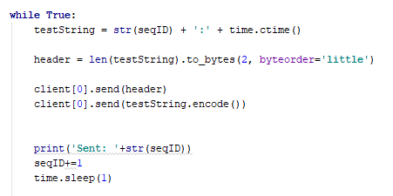
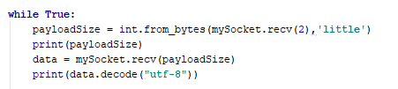
Managing Network Data
  Approach 3: variable length packets
Client.py
Server.py
Sending size+data is the core of serialisation / deserialization
See C# serialisation for more details

Slide 20
Managing Network Data
  Approach 4: JSON
    JSON allows us to send complex data as an encoded text string that can be examined as an organised data type in Python
      Saw this in COMP130 last year

Slide 21
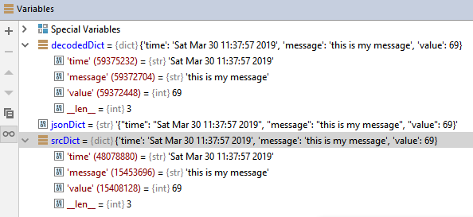
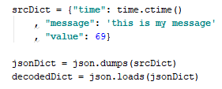
Managing Network Data
  Approach 4: JSON
    JSON allows us to send complex data as an encoded text string that can be examined as an organised data type in Python
      Saw this in COMP130 last year

Slide 22
Managing Network Data
  Approach 4: JSON
    Combine this with the variable length packet, so:
      1. Make Python data dictionary
      2. Convert to JSON
      3. Send packet size len(JSON data)
      4.Send JSON data as bytes (JSON.encode)
    On the client
      1. Read payload size
      2. Read payload
      3. JSON.loads(payload)

Slide 23
Managing Network Data
  Approach 4: JSON
    Effectively this is still a data packet of:
      <LENGTH.2><DATA.N>
      With more data encoding in the <DATA.N> part

Slide 24
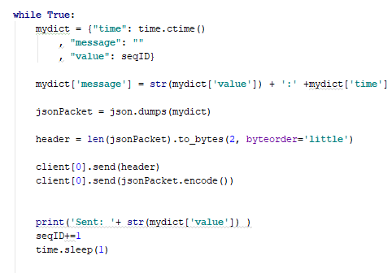
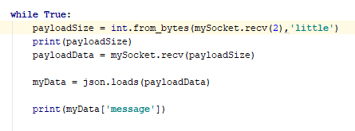
Managing Network Data
  Approach 4: JSON
Client.py
Server.py

Slide 25
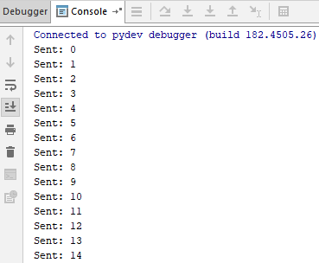
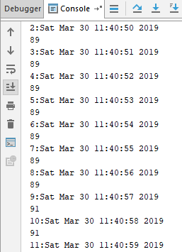
Managing Network Data
  Approach 4: JSON
Server.py
Client.py

Slide 26
Managing Network Data
  Are these my packets?
    We’ve seen that (currently) everyone’s clients and servers are fairly interchangeable
      You’re using the same protocol
        data packets of byte streams
    Let’s put a stamp on our packets so we know they belong to the application

Slide 27
Managing Network Data
  Are these my packets?
    Already, we are assuming a packet format of
      <LENGTH.2><DATA.N>
    If we add an ID to the packet, we’ll know it’s ours
      <ID.4><LENGTH.2><DATA.N>

Slide 28
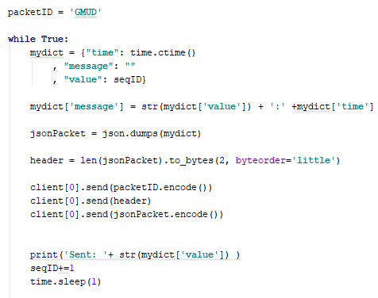
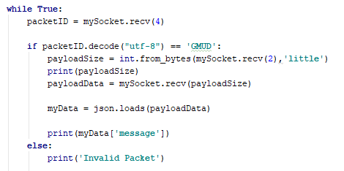
Managing Network Data
  Are these my packets?
Client.py
Server.py

Slide 29
Managing Network Data
  Are these my packets?
Client.py
Server.py
Client.py

Slide 30
Managing Network Data
  Passive and active attacks from wk5
    Passive: reading the contents
      How do we stop people?
        Encryption / Decryption (next week)
    Active: ‘doing things with packets’
      Message replay
      Message modification
      Message spamming

Slide 31
Managing Network Data
  Passive and active attacks from wk5
    Passive: reading the contents
      How do we stop people?
        Encryption / Decryption (next week)
    Active: ‘doing things with packets’
      Message replay
        Stop messages from being replayed by encoding sequences into packets
      Message modification
        Stop modification by encrypting packet contents
      Message spamming

Slide 32
Managing Network Data
  Using packet sequence numbers to stop replay hacks
    A replay hack consists of a stream of client -> server messages being captured and then replayed
Client
Server

Slide 33
Managing Network Data
  Using packet sequence numbers to stop replay hacks
    A replay hack consists of a stream of client -> server messages being captured and then replayed
Man
in the
middle
Client
Server
Saved
packets

Slide 34
Managing Network Data
  Using packet sequence numbers to stop replay hacks
    A replay hack consists of a stream of client -> server messages being captured and then replayed
Packet
Replay
Client
Server
Saved
packets

Slide 35
Managing Network Data
  Using packet sequence numbers to stop replay hacks
    Simple sequencing
      Client and server set sequence ID to 0 on connect/accept
      Client sends sequence as part of packet & increments
      Server tests on packet receipt
      Remember, TCP packet will always arrive and in the correct order
    Session sequencing
      As above,
      But server will assign session ID to client on accept
      Client adds that to packet send data
      Server tests on packet receipt

Slide 36
Managing Network Data
  Using packet sequence numbers to stop replay hacks
    Simple sequencing
      If sequence number is out of sync -> packet replay / packet hacking
    Session sequencing
      If session ID is wrong -> packet replay / packet hacking

Slide 37
Managing Network Data
  Using packet sequence numbers to stop replay hacks
    Simple sequencing
      If sequence number is out of sync -> packet replay / packet hacking
    Session sequencing
      If session ID is wrong -> packet replay / packet hacking

Slide 38
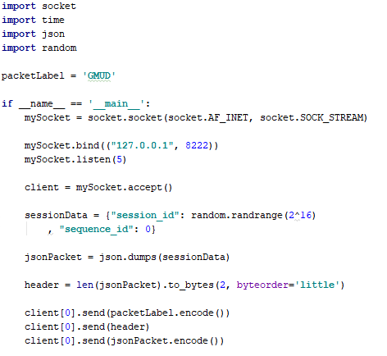
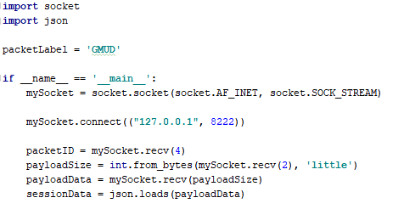
Managing Network Data
  Approach 6: sequence numbers
    Part 1: send session data
Client.py
Server accepts client and sends session data as json packet
Client receives json data and decodes
Server.py

Slide 39
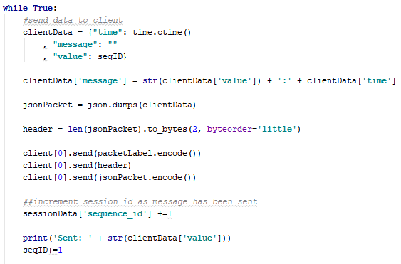
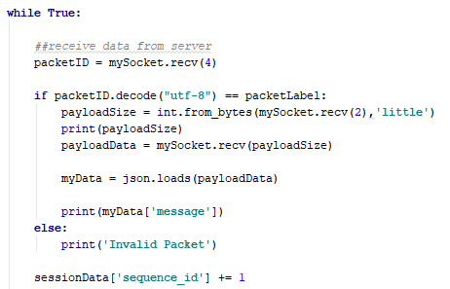
Managing Network Data
  Approach 6: sequence numbers
    Part 2: server sends ‘normal’ data, client receives
Client.py
Server.py
Session data is updated on both sides

Slide 40
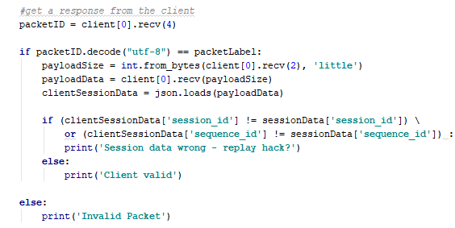
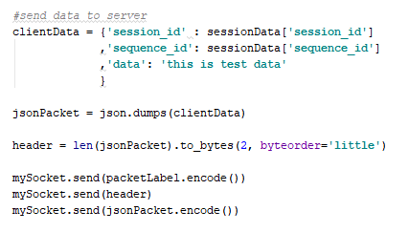
Managing Network Data
  Approach 6: sequence numbers
    Part 3: client sends data to server which is validated
Client.py
Server.py
Client sends a message to server with session data
Server decodes and validates

Slide 41
Managing Network Data
  Approach 6: sequence numbers
    Rather than ‘just’ being about data, it’s also about communications between client and server

Slide 42
Workshop
  This week: hosting your server apps on a remote linux server

Slide 43
Questions

